Slide 1

NETWORK! Because, sometimes it’s not what you know, it’s
WHO YOU KNOW!

Slide 2

When you network well:
Recruiters will notice you.
You will have a more successful career.
You will feel better about yourself.

Slide 3

You will network with…
People you ALREADY KNOW.
People you WANT TO KNOW.
People you NEED TO KNOW.
And, maybe, people who
WANT TO KNOW YOU!

Slide 4


It’s all Social
Face-to-Face
Receptions
Parties
Coffee breaks
Social Media
LinkedIn
Facebook
WeChat

Slide 5

WHY do you hesitate to network?
Because your mothers told you, “Don’t Talk to Strangers!”

Slide 6

According to the NY Times, “The #1 SOCIAL FEAR is going to…
…a party with strangers.”

Slide 7
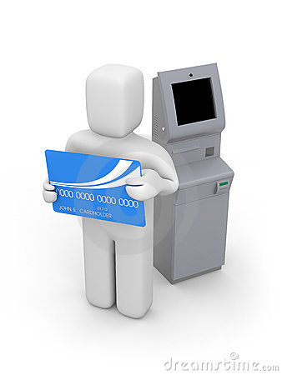



It’s NATURAL to feel alone, because we spend so much time alone.

Slide 8

Are you an INTROVERT?
Don’t worry. In the 1980’s, 80% of adults identified themselves as shy;
in 2000, 93% did.

Slide 9
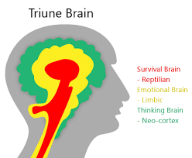
MINGLING IS a MIND GAME.

Slide 10

In a non-conscious process, the brain responds in the following ways:
THE LIZARD BRAIN decides: do I fight, flee or feed (survival mode).
You can overcome this by being open, non-threatening
Next, the SOCIAL BRAIN makes value judgements.
So, be professional, confident, poised, to be worthy of their time
Lastly, NEO CORTEX (thinking) is engaged.
Give high value and novel ideas, high contrast and binary information

Slide 11


YOU CAN MASTER

Slide 12

First, ELIMINATE NEGATIVE SELF-TALK.

Slide 13

Next, have
Increase connections/contacts
Get a job
Gain insights/learn
Be visible
Have fun

Slide 14
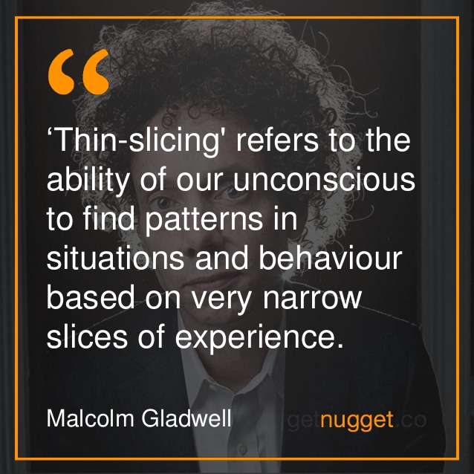
Think about your IMAGE:
You are giving off messages LONG BEFORE you speak.

Slide 15

Adopt a POSITIVE ATTITUDE.
Don’t use negatives, don’t gossip, don’t use profanity.

Slide 16

Know your body language!

Slide 17
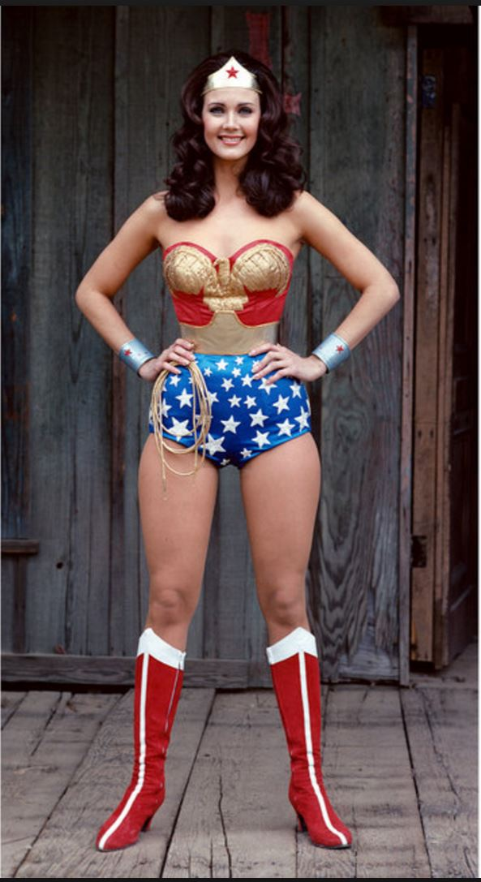

Take a POWER STANCE.

Slide 18

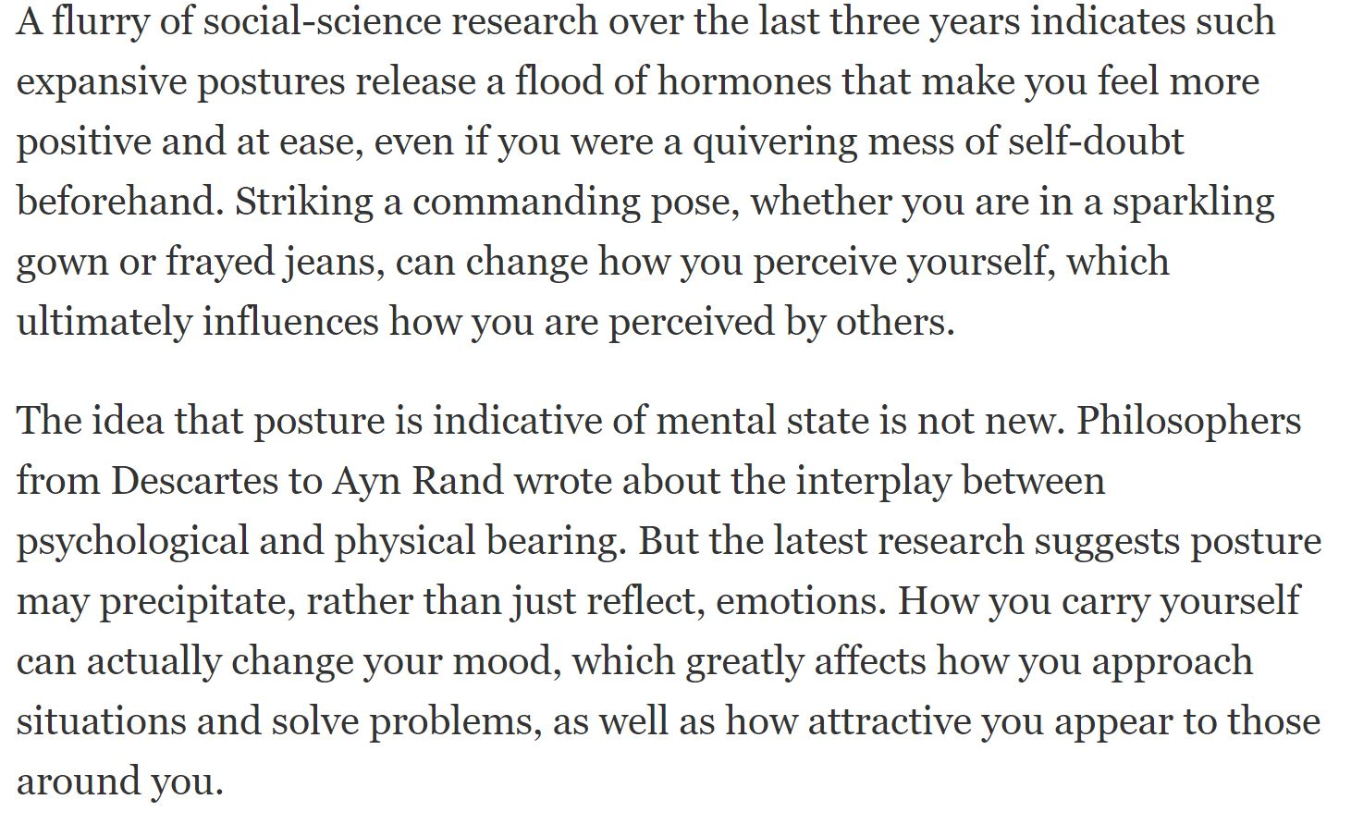
Do Power Poses work?

Slide 19
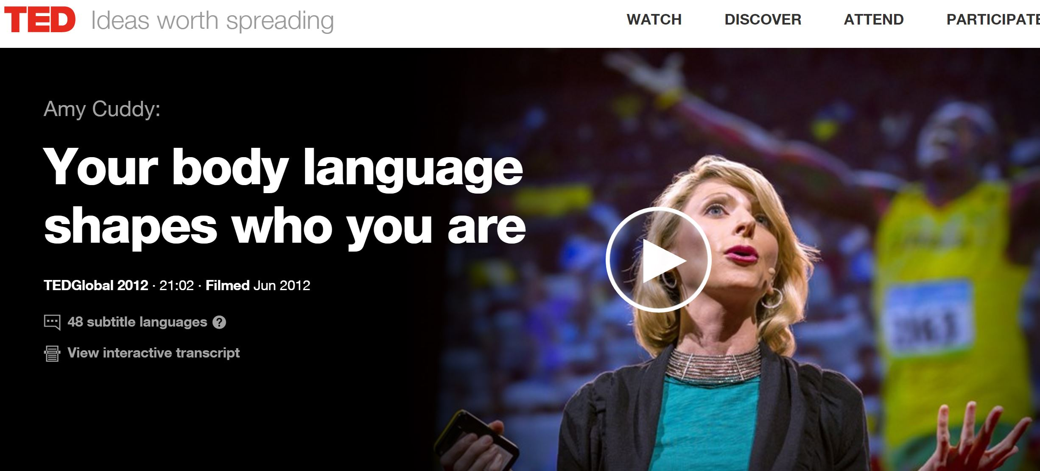
WATCH THIS TEDTalk!
https://www.ted.com/talks/amy_cuddy_your_body_language_shapes_who_you_are

Slide 20
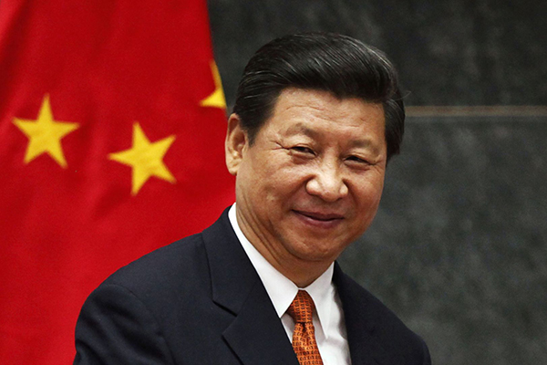
Channel a professional!

Slide 21



DRESS FOR THE OCCASION.

Slide 22
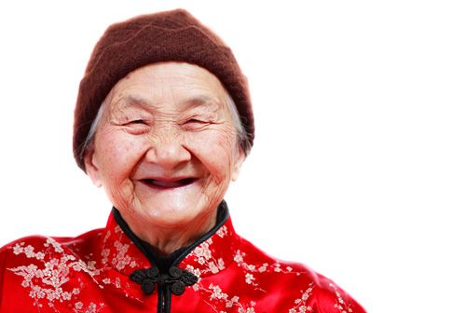
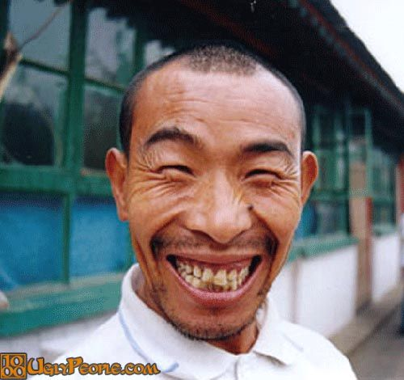

SMILE!

Slide 23

Give a firm handshake.

Slide 24

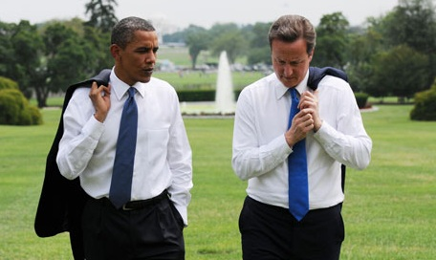

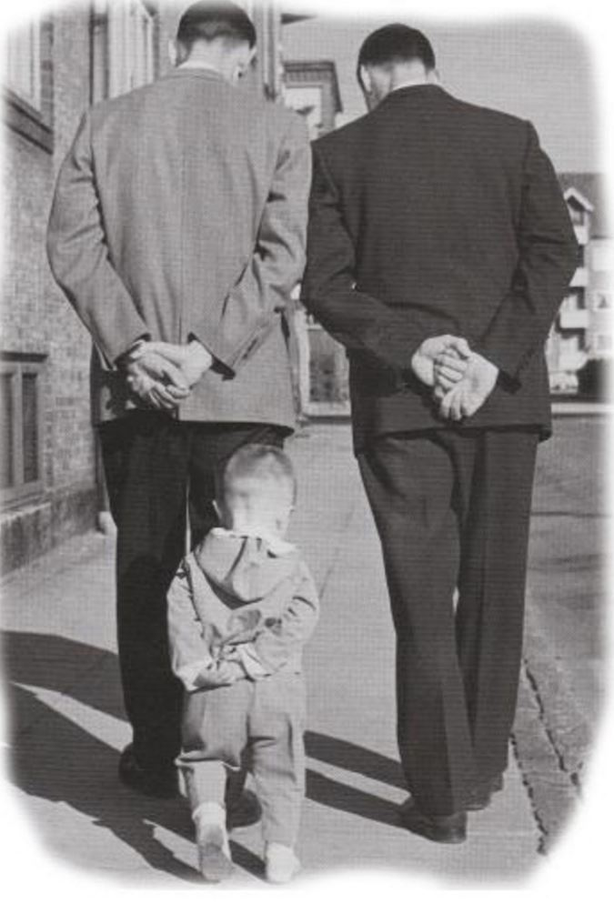
MirrorrorriM your audience.

Slide 25

HAVE A SELF INTRODUCTION READY.
But, don’t talk about your title; talk about your

Slide 26

Set the stage and find some things in common.
Ask about the person’s job and employer (know something about both).
Show your commonalities.
Ask a question related to your commonalities.
Share a goal.
Tell a story.

Slide 27
Use these techniques:
QUESTION: “What is the one best piece of advice you’d give to someone just starting in this field?”
HONESTY: “I don’t know anybody here.”
FLATTERY: “I was told that if I met anyone, I should meet you….”
PRAISE: “ I really like your (tie, earrings, necklace, glasses, scarf)….”
NEWS ITEM: “Did you hear about the shakeup over at DB?”
STORY: “I was driving to Connecticut last winter during a snow storm….”
HELP: “Can you introduce me to one person you think I should meet?”

Slide 28

Create a conversation, a dialogue.
This should come from genuine interest. For instance, ask where the person is from.
Share the meaning of your name.
Tell an interesting story.

Slide 29

Don’t get STUCK on one topic.
HAVE SEVERAL TOPICS IN MIND.
Start with the weather, perhaps, move on to an article you read; get rapport going and if that fails….

Slide 30

STAND BY THE FOOD!
Taste the food. Recommend it to people to open a conversation.

Slide 31

USE YOUR EYES!
Make eye contact. Look deeply, but briefly. Remember their eye color.

Slide 32
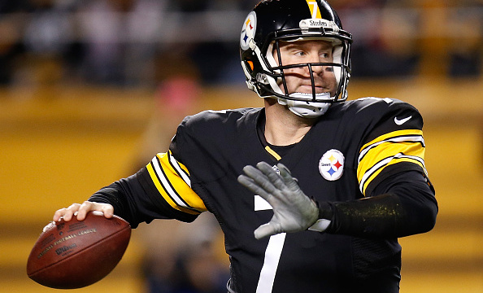
THINK P.R.O.
PRIMACY
RECENCY
ODDITY
People will remember the first thing you said (Primacy).
They will remember the last thing you said (Recency).
And, they will remember an odd thing you said (Oddity).

Slide 33

PARTICIPATE. It’s a DIALOGUE.
Nod
Smile
Laugh
Listen
Ask Questions
Re-state their points
Open your body language
Mirror the audience

Slide 34

Do your homework!
Know the world of finance.
Take a position and defend it.
Be passionate.
Stay on top of the news.
Never be boring.

Slide 35

Obey these “No No’s.”
No religious talk
No politics
No cell phones
No touching
No talking with mouth full
No bad breath or body odor
No inappropriate jokes
No overdoing the alcohol

Slide 36

Be a HOST(ESS), NOT A GUEST.
Smile
Greet people
Help others
Get drinks
Listen
Introduce people

Slide 37
Know When to Move On.
You may find yourself with someone who can’t help you further your goal (expand your network). If so, excuse yourself.
Say you must:
Feed the meter, powder your nose, get some food, or
Answer the vibrating cell phone.
Say you want to take less of the person’s time,
Fade out; don’t latch on to someone; explore the room.
Bring someone else in to “change the guard,” or
Shake hands and break away.

Slide 38
To OWN the room, YOU MUST:
Practice
Practice
Practice
Practice
Practice
Practice
Practice
Practice

Slide 39
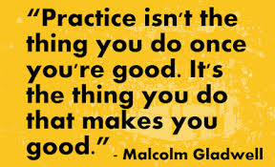

Slide 40

WE are going to PRACTICE… NOW!
Grab a partner.

